Slide 1


International Education Cost Analysis
Study Abroad
- By Jujare Manasa

Slide 2

INTRODUCTION
Studying abroad gives students global learning and better career opportunities.
Every year, millions of students move abroad for higher education.
But studying abroad is very expensive with costs like tuition, rent, visa, insurance, and living.
Knowing these costs in advance helps students and families plan wisely and avoid financial stress.

Slide 3

Project Motive
01
Aim of this Data selection

Slide 4

To analyze international education costs using Power BI.
To find out which countries are expensive and which are affordable.
To identify the main cost drivers like tuition, rent, and insurance.
To help students and families plan better for studying abroad.

Slide 5
Dataset scope
Dataset collected from Kaggle.
Covers 71 countries and 622 universities.
Includes details like education cost, rent, insurance, visa, living cost.
Total of 92 programs across different levels and universities.

Slide 6

Analytical Insights
02
Global Insights Overview

Slide 7

Total Countries: 71
Total Universities: 622
Average Cost per Year: 7.24K USD
Most Expensive Country: USA
Least Expensive Country: Nigeria
Overall Education Cost Globally: 17M USD

Slide 8
Key Findings – Cost Analysis
USA has the highest total cost (4M USD), followed by Australia and UK.
Nigeria is the most affordable option.
Rent (51.5%) is the largest cost component, followed by insurance (37.2%) and visa (11.2%).
University comparison shows University of Salford, UWE Bristol, and Imperial College London as most expensive (34K–37K USD per year).

Slide 9
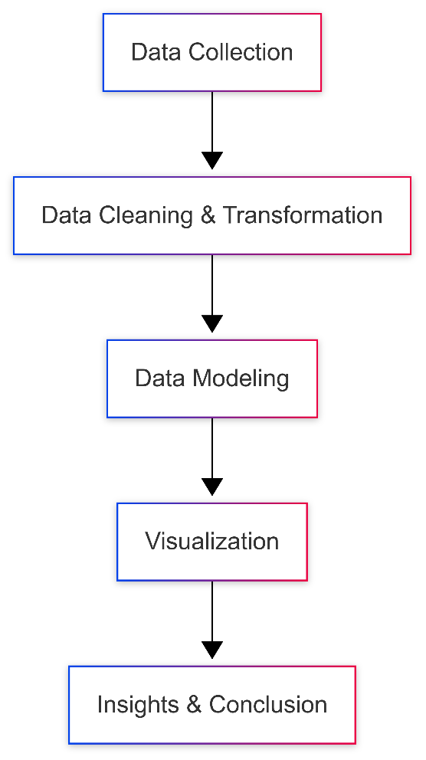
Project Workflow
Data Collection – Dataset from Kaggle.
Data Cleaning & Transformation – Using Power BI Power Query.
Data Modeling – Creating relationships between cost, country, university, and program.
Visualization – Dashboards with KPIs, charts, slicers.
Insights & Conclusion – Key takeaways for decision-making.

Slide 10
Conclusion
Studying abroad offers great opportunities but comes with high financial challenges.
Families and students should plan well in advance.
Power BI analysis gives a transparent view of global costs.
Helps in identifying the right country/university based on budget.
Supports better financial planning and stress-free education journey.

Slide 11
Thankyou

